Slide 1
Chapter 3
Agile Development
Slide Set to accompany
Software Engineering: A Practitioner’s Approach, 7/e
by Roger S. Pressman
Slides copyright © 1996, 2001, 2005, 2009 by Roger S. Pressman
For non-profit educational use only
May be reproduced ONLY for student use at the university level when used in conjunction with Software Engineering: A Practitioner's Approach, 7/e. Any other reproduction or use is prohibited without the express written permission of the author.
All copyright information MUST appear if these slides are posted on a website for student use.
These slides are designed to accompany Software Engineering: A Practitioner’s Approach, 7/e (McGraw-Hill, 2009) Slides copyright 2009 by Roger Pressman.

Slide 2
The Manifesto for
Agile Software Development
“We are uncovering better ways of developing software by doing it and helping others do it. Through this work we have come to value:
  Individuals and interactions over processes and tools
  Working software over comprehensive documentation
  Customer collaboration over contract negotiation
  Responding to change over following a plan
That is, while there is value in the items on the right, we value the items on the left more.”
Kent Beck et al
These slides are designed to accompany Software Engineering: A Practitioner’s Approach, 7/e (McGraw-Hill, 2009) Slides copyright 2009 by Roger Pressman.

Slide 3
What is “Agility”?
Effective (rapid and adaptive) response to change
Effective communication among all stakeholders
Drawing the customer onto the team
Organizing a team so that it is in control of the work performed
Yielding …
Rapid, incremental delivery of software
These slides are designed to accompany Software Engineering: A Practitioner’s Approach, 7/e (McGraw-Hill, 2009) Slides copyright 2009 by Roger Pressman.

Slide 4

Agility and the Cost of Change
These slides are designed to accompany Software Engineering: A Practitioner’s Approach, 7/e (McGraw-Hill, 2009) Slides copyright 2009 by Roger Pressman.

Slide 5
An Agile Process
Is driven by customer descriptions of what is required (scenarios)
Recognizes that plans are short-lived
Develops software iteratively with a heavy emphasis on construction activities
Delivers multiple ‘software increments’
Adapts as changes occur
These slides are designed to accompany Software Engineering: A Practitioner’s Approach, 7/e (McGraw-Hill, 2009) Slides copyright 2009 by Roger Pressman.

Slide 6
Agility Principles - I
1. Our highest priority is to satisfy the customer through early and continuous delivery of valuable software.
2. Welcome changing requirements, even late in development. Agile processes harness change for the customer's competitive advantage.
3. Deliver working software frequently, from a couple of weeks to a couple of months, with a preference to the shorter timescale.
4. Business people and developers must work together daily throughout the project.
5. Build projects around motivated individuals. Give them the environment and support they need, and trust them to get the job done.
6. The most efficient and effective method of conveying information to and within a development team is face–to–face conversation.
These slides are designed to accompany Software Engineering: A Practitioner’s Approach, 7/e (McGraw-Hill, 2009) Slides copyright 2009 by Roger Pressman.

Slide 7
Agility Principles - II
7. Working software is the primary measure of progress.
8. Agile processes promote sustainable development. The sponsors, developers, and users should be able to maintain a constant pace indefinitely.
9. Continuous attention to technical excellence and good design enhances agility.
10. Simplicity – the art of maximizing the amount of work not done – is essential.
11. The best architectures, requirements, and designs emerge from self–organizing teams.
12. At regular intervals, the team reflects on how to become more effective, then tunes and adjusts its behavior accordingly.
These slides are designed to accompany Software Engineering: A Practitioner’s Approach, 7/e (McGraw-Hill, 2009) Slides copyright 2009 by Roger Pressman.

Slide 8
Human Factors
the process molds to the needs of the people and team, not the other way around
key traits must exist among the people on an agile team and the team itself:
  Competence.
  Common focus.
  Collaboration.
  Decision-making ability.
  Fuzzy problem-solving ability.
  Mutual trust and respect.
  Self-organization.
These slides are designed to accompany Software Engineering: A Practitioner’s Approach, 7/e (McGraw-Hill, 2009) Slides copyright 2009 by Roger Pressman.

Slide 9
Extreme Programming (XP)
The most widely used agile process, originally proposed by Kent Beck
XP Planning
  Begins with the creation of “user stories”
  Agile team assesses each story and assigns a cost
  Stories are grouped to for a deliverable increment
  A commitment is made on delivery date
  After the first increment “project velocity” is used to help define subsequent delivery dates for other increments
These slides are designed to accompany Software Engineering: A Practitioner’s Approach, 7/e (McGraw-Hill, 2009) Slides copyright 2009 by Roger Pressman.

Slide 10
Extreme Programming (XP)
XP Design
  Follows the KIS principle
  Encourage the use of CRC cards (see Chapter 8)
  For difficult design problems, suggests the creation of “spike solutions”—a design prototype
  Encourages “refactoring”—an iterative refinement of the internal program design
XP Coding
  Recommends the construction of a unit test for a store before coding commences
  Encourages “pair programming”
XP Testing
  All unit tests are executed daily
  “Acceptance tests” are defined by the customer and excuted to assess customer visible functionality
These slides are designed to accompany Software Engineering: A Practitioner’s Approach, 7/e (McGraw-Hill, 2009) Slides copyright 2009 by Roger Pressman.

Slide 11

Extreme Programming (XP)
These slides are designed to accompany Software Engineering: A Practitioner’s Approach, 7/e (McGraw-Hill, 2009) Slides copyright 2009 by Roger Pressman.

Slide 12
Adaptive Software Development
Originally proposed by Jim Highsmith
ASD — distinguishing features
  Mission-driven planning
  Component-based focus
  Uses “time-boxing” (See Chapter 24)
  Explicit consideration of risks
  Emphasizes collaboration for requirements gathering
  Emphasizes “learning” throughout the process
These slides are designed to accompany Software Engineering: A Practitioner’s Approach, 7/e (McGraw-Hill, 2009) Slides copyright 2009 by Roger Pressman.

Slide 13
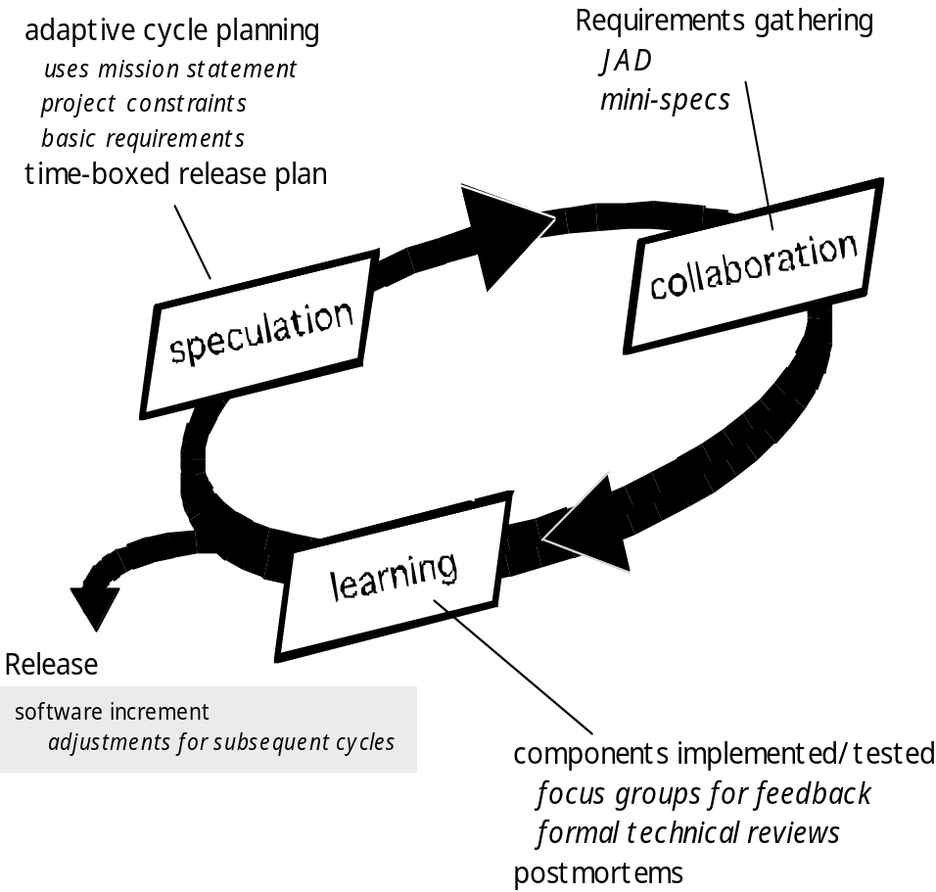
Adaptive Software Development
These slides are designed to accompany Software Engineering: A Practitioner’s Approach, 7/e (McGraw-Hill, 2009) Slides copyright 2009 by Roger Pressman.

Slide 14
Dynamic Systems Development Method
Promoted by the DSDM Consortium (www.dsdm.org)
DSDM—distinguishing features
  Similar in most respects to XP and/or ASD
  Nine guiding principles
    Active user involvement is imperative.
    DSDM teams must be empowered to make decisions.
    The focus is on frequent delivery of products.
    Fitness for business purpose is the essential criterion for acceptance of deliverables.
    Iterative and incremental development is necessary to converge on an accurate business solution.
    All changes during development are reversible.
    Requirements are baselined at a high level
    Testing is integrated throughout the life-cycle.
These slides are designed to accompany Software Engineering: A Practitioner’s Approach, 7/e (McGraw-Hill, 2009) Slides copyright 2009 by Roger Pressman.

Slide 15
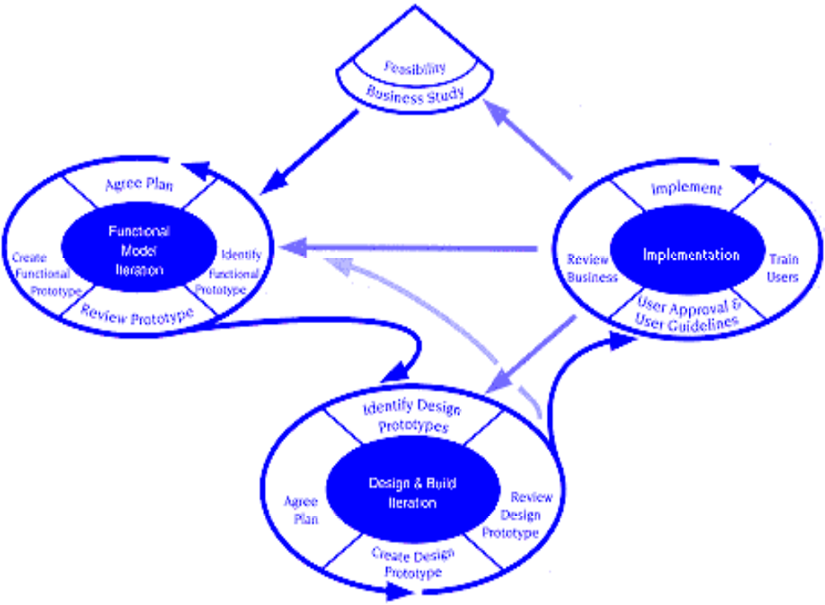
Dynamic Systems Development Method
DSDM Life Cycle (with permission of the DSDM consortium)
These slides are designed to accompany Software Engineering: A Practitioner’s Approach, 7/e (McGraw-Hill, 2009) Slides copyright 2009 by Roger Pressman.

Slide 16
Scrum
Originally proposed by Schwaber and Beedle
Scrum—distinguishing features
  Development work is partitioned into “packets”
  Testing and documentation are on-going as the product is constructed
  Work occurs in “sprints” and is derived from a “backlog” of existing requirements
  Meetings are very short and sometimes conducted without chairs
  “demos” are delivered to the customer with the time-box allocated
These slides are designed to accompany Software Engineering: A Practitioner’s Approach, 7/e (McGraw-Hill, 2009) Slides copyright 2009 by Roger Pressman.

Slide 17
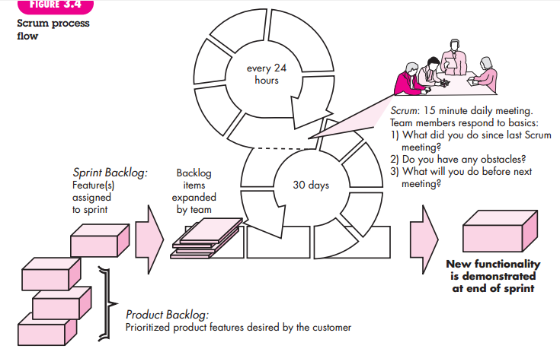
These slides are designed to accompany Software Engineering: A Practitioner’s Approach, 7/e (McGraw-Hill, 2009) Slides copyright 2009 by Roger Pressman.

Slide 18
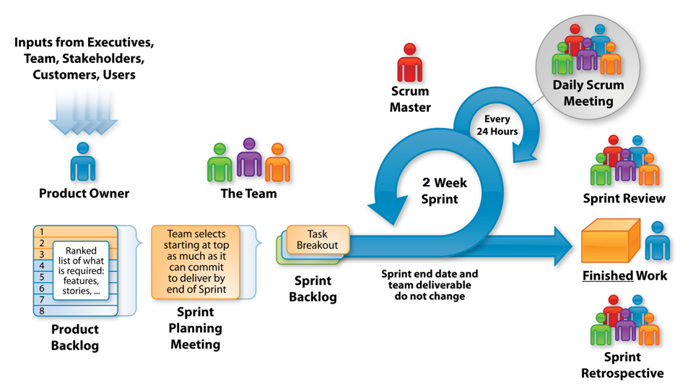
These slides are designed to accompany Software Engineering: A Practitioner’s Approach, 7/e (McGraw-Hill, 2009) Slides copyright 2009 by Roger Pressman.

Slide 19
Crystal
Proposed by Cockburn and Highsmith
Crystal—distinguishing features
  Actually a family of process models that allow “maneuverability” based on problem characteristics
  Face-to-face communication is emphasized
  Suggests the use of “reflection workshops” to review the work habits of the team
These slides are designed to accompany Software Engineering: A Practitioner’s Approach, 7/e (McGraw-Hill, 2009) Slides copyright 2009 by Roger Pressman.

Slide 20
Feature Driven Development
Originally proposed by Peter Coad et al
FDD—distinguishing features
  Emphasis is on defining “features”
    a feature “is a client-valued function that can be implemented in two weeks or less.”
  Uses a feature template
    <action> the <result> <by | for | of | to> a(n) <object>
  A features list is created and “plan by feature” is conducted
  Design and construction merge in FDD
These slides are designed to accompany Software Engineering: A Practitioner’s Approach, 7/e (McGraw-Hill, 2009) Slides copyright 2009 by Roger Pressman.

Slide 21
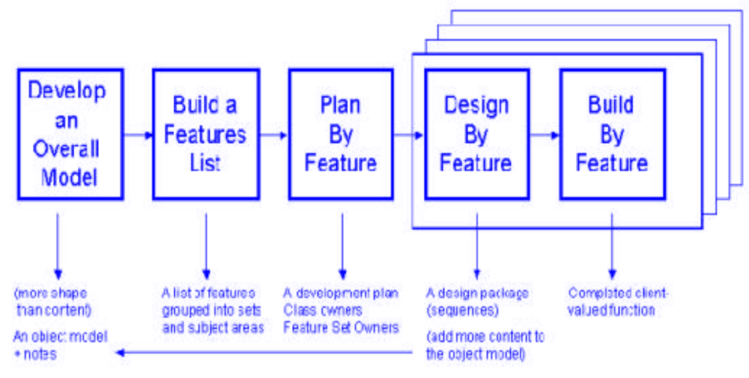
Feature Driven Development
Reprinted with permission of Peter Coad
These slides are designed to accompany Software Engineering: A Practitioner’s Approach, 7/e (McGraw-Hill, 2009) Slides copyright 2009 by Roger Pressman.

Slide 22
Agile Modeling
Originally proposed by Scott Ambler
Suggests a set of agile modeling principles
  Model with a purpose
  Use multiple models
  Travel light
  Content is more important than representation
  Know the models and the tools you use to create them
  Adapt locally
These slides are designed to accompany Software Engineering: A Practitioner’s Approach, 7/e (McGraw-Hill, 2009) Slides copyright 2009 by Roger Pressman.

